Slide 1
Computer Networks: Unit 4- MAC Layer
Prof. Swarnalata Bollavarapu
Contact: swarnalata.b@nmims.edu

Slide 2
Contents
The channel allocation problem
Multiple Access Protocols
Ethernet
Data link layer switching
The LAN, WAN design issues.
Ref Book: Tanenbaum, “Computer Networks”

Slide 3
Introduction
Multiple Senders
Single Channel
Issue: How to determine who gets to use the channel when there is competition for it?
Broadcast channel is also referred as multi access channel
The protocol used to determine who goes next in multi access channel is known as Medium Access Control Protocol (MAC protocols)
MAC protocols are at MAC (Medium Access control) layer
MAC is a sub layer of Data link layer

Slide 4
The Channel Allocation Problem
How to allocate a single broadcast channel among competing user?

Slide 5
The Channel Allocation Problem
Two types of channel allocation:
Static Channel allocation
Dynamic channel allocation

Slide 6
Static Channel Allocation in LANs and MANs
The traditional way of allocating a single channel:
FDM
TDM
FDM : N users, bandwidth is divided into N equal sized portions, each user being assigned one portion
No interference as each user having private frequency band
When there are few users and each of which has a heavy load FDM is a simple and efficient mechanism

Slide 7
Static Channel Allocation in LANs and MANs
Disadvantage of FDM:
Cannot support more senders
If number of senders is large and traffic is bursty FDM will give an error
N users : fewer users are communicating , bandwidth will be wasted
If more than N users want to communicate, some of them will be denied permission for lack of bandwidth even though some users who are assigned bandwidth hardly transmits.

Slide 8
Static Channel Allocation in LANs and MANs
TDM:
Each user is statically allocated every Nth time slot.
If a user does not use the allocated slot, it is just wasted
None of the traditional static channel allocation methods work well with bursty traffic

Slide 9
Dynamic Channel Allocation in LANs and MANs
Assumptions for dynamic channel allocation:
Station model
Single channel assumption
Collision assumption
Continuous Time
Slotted Time
Carrier Sense
No Carrier Sense

Slide 10
Station Model
Model consist of N independent stations(computer, telephones or personal communicators)
Each station will have program to generate frame
Stations are sometimes called terminals
The probability of frame being generated in the interval of length ∆t is lamda ∆t , where lamda is a constant (arrival rate of new frames).
Once a frame is generated station is blocked and will do nothing till frame is transmitted

Slide 11
Single Channel Assumption
A single channel is available
All stations can transmit on it and receive on it

Slide 12
Collision Assumption
If two frames are transmitted simultaneously, they overlap in time and the resulting signal is garbled. This event is called collision
All stations can detect collisions
A collided frame must be retransmitted again later
There are no errors other than generated by collision

Slide 13
Continuous Time
Frame transmission can begin at any time
There is no master clock dividing time intervals into discrete intervals

Slide 14
Slotted Time
Time is divided into discrete intervals (Slots)
Frame transmission will start at the starting of each slot
A slot may contain 0, 1 or more frames

Slide 15
Carrier Sense
Stations can tell if the channel is in use before trying to use it
If the channel is busy no other station will try to use it until it becomes free

Slide 16
No Carrier Sense
Stations cannot determine whether channel is free.
They just start transmitting, later on they come to know if transmission was successful

Slide 17
recap
What does MAC stand for?
Where is the placement of the MAC sublayer in the OSI reference model?
Role of MAC sublayer
What is channel allocation problem?
Types of channel allocation
Assumptions of channel allocation

Slide 18
Multiple Access Protocols
Several multiple access protocols like:
Aloha
Pure Aloha
Slotted Aloha
Carrier Sense Multiple Access(CSMA)
Carrier Sense Multiple Access with collision Avoidance(CSMA/CA)
Carrier Sense Multiple Access with Collision Detection (CSMA/CD)

Slide 19
ALOHA
Norman Abramson and his colleagues developed it at university of Hawaii in 1970s.
Used to solve channel allocation problem
Work has been extended by many researchers
Applicable to any system in which uncoordinated users are competing for single channel allocation
Types: Pure Aloha and Slotted Aloha

Slide 20
Pure ALOHA
Basic idea : Let users transmit whenever they have data to be sent
There will be collisions, colliding frames will be destroyed
Transmitter will come to know about collision by listening to channel (Sensing the medium)
If listening while transmitting is not possible some feedback mechanism of ACK is required
Sender will wait for ACK, if frame is destroyed, ACK will not arrive within some random amount of time then sender will retransmit

Slide 21
Pure ALOHA
Sender will wait for random amount of time
The waiting time is random so that there is no collision of same frame again and again
Systems in which multiple users share same channel in a way that can lead to collisions are widely known as contention systems.

Slide 22
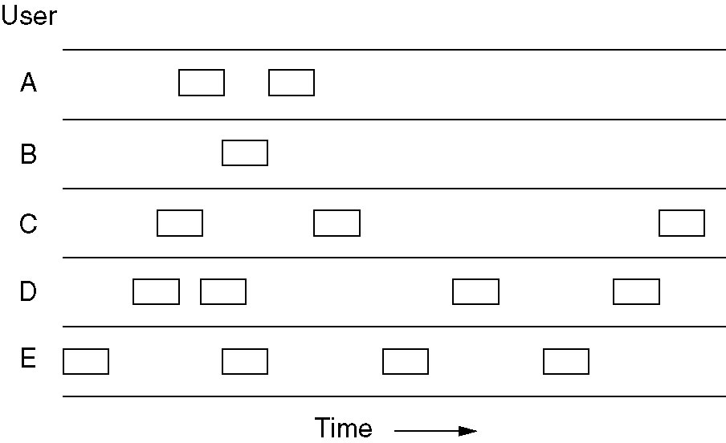
Pure ALOHA
Whenever two frames try to occupy channel at the same time, there will be a collision and both will be garbled. If the first bit of a new frame overlaps with last bit of a frame almost finished , both frames will be totally destroyed and both will have to be retransmitted

Slide 23
Pure ALOHA
A frame will not suffer a collision if no other frames are sent within one frame time(Time required to transmit frame)
Let t be the time required to send a frame
If any other user has generated a frame between time t₀ and t₀+t , the end of that frame will collide with the beginning of next frame.
In Aloha, station do not listen to the channel before transmitting so it has no way of knowing that transmission of another frame is going on
Similarly any other frame starting between t₀ + t and t₀ + 2t will also suffer from collision

Slide 24
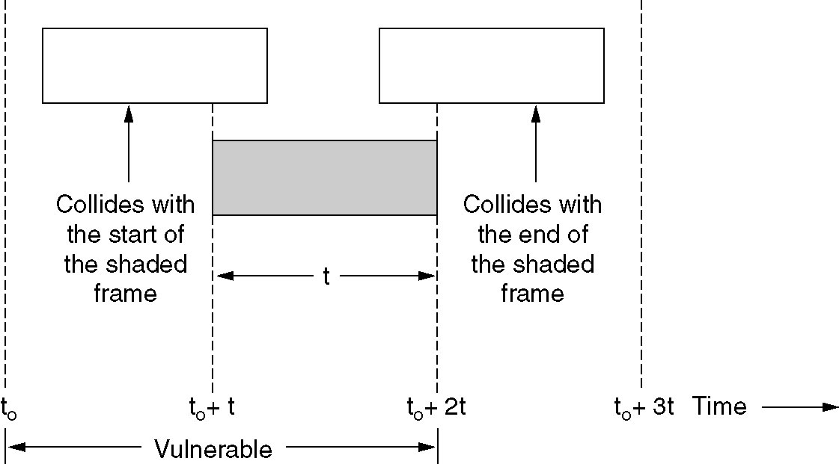
Pure ALOHA

Slide 25
Slotted ALOHA
Divide time into discrete intervals
Each interval corresponding to one frame
Each user should agree on slot boundaries
One way to achieve SYNC is a special station emit a pip at the start of each interval
This method is known as Slotted Aloha
User is not permitted to transmit whenever it wants to instead need to wait till next slot begins

Slide 26
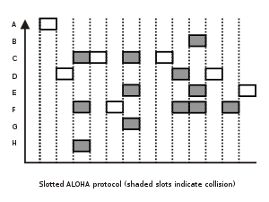
Slotted ALOHA

Slide 27
Differentiate between Pure Aloha and Slotted Aloha?

Slide 28
Carrier Sense Multiple Access Protocols
In Aloha stations transmit without checking what other stations are doing
So there are many collisions in slotted Aloha
Protocols in which station can listen for a carrier(i.e., transmission) and act accordingly are called carrier sense protocols.
Types of Carrier Sense Protocols:
Persistent CSMA
1-Persistent
P-Persistent
Non Persistent CSMA
CSMA with Collision Detection (CSMA/CD)
CSMA with Collision Avoidance (CSMA/CA)

Slide 29
1-Persistant CSMA
When station has data to send :
Station first listens to the channel to see if anyone else is transmitting
If anyone else is transmitting (channel is busy) it will wait till channel become free
When channel detects an idle channel it will transmit frame
If a collision occurs: wait for random amount of time and start again
Known as 1-Persistant because station transmit with probability of 1 when it finds the channel idle

Slide 30
1-Persistant CSMA
Problem: If one station finds channel idle and start transmitting, signal has not yet reached the second one, second one will also sense the medium idle and will also start transmitting result in collision
Longer the propagation delay, worse the performance of the protocol

Slide 31
1-Persistant CSMA
Even if propagation delay is zero, there will still be collisions
How?
If two stations become ready to transmit and third one is already transmitting. Both will wait for till third one completes. But as soon as third one stops both will start together and will cause collision.

Slide 32
P-Persistent CSMA
Applies to Slotted channel
Station wants to send data
Station will sense the channel
If it is idle, it transmits with a probability of P
With a probability Q= 1-P, it defers until the next slot
If that slot is free it either transmits or defers again with probability of P and Q
Process is repeated till frame has been transmitted of some other station has begun transmitting
If station initially sense the channel busy, it waits until the next slot and applies the above algorithm

Slide 33
Non-Persistent CSMA
Station wants to transmit
Station sense the medium (channel)
If channel is busy station will stop sensing and wait for random amount of time and will start again
Non-Persistent CSMA is less greedy than 1-Persistent, it does not try to immediately grab the channel as soon as it gets free.

Slide 34
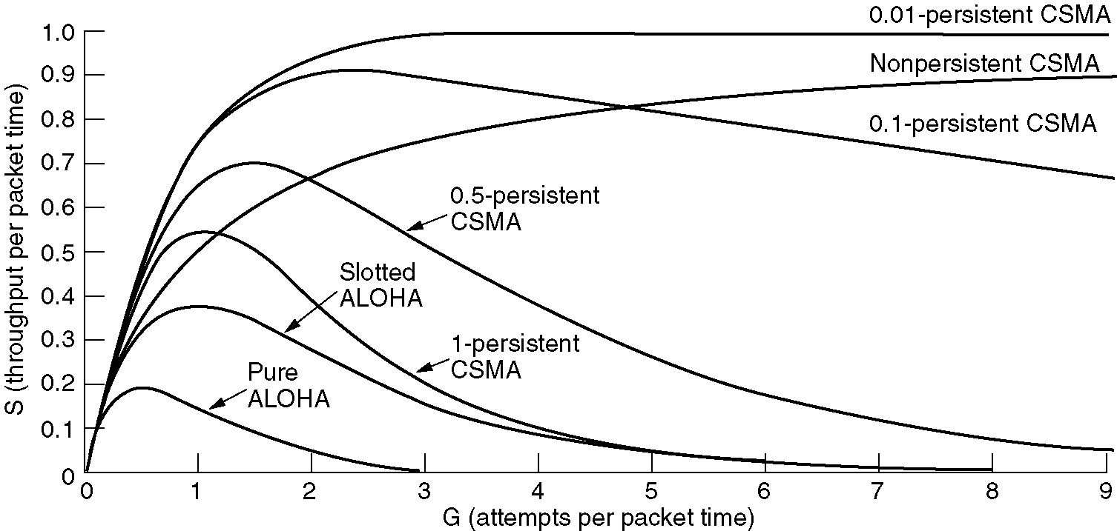
Comparison of channel utilization versus load for various random access protocols

Slide 35
1-Persistant CSMA better than slotted Aloha. How?

Slide 36
CSMA with collision detection
Persistent and non-persistent : improvement over ALOHA
Another improvement: Stations to abort transmission as soon as they detect a collision
If two stations sense the medium to be idle and begin transmitting simultaneously
Both will detect collision together
Rather than transmitting frames that are already garbled they should stop transmitting as soon as collision is detected
Advantage: ? :
Quickly stopping transmission saves bandwidth and time

Slide 37
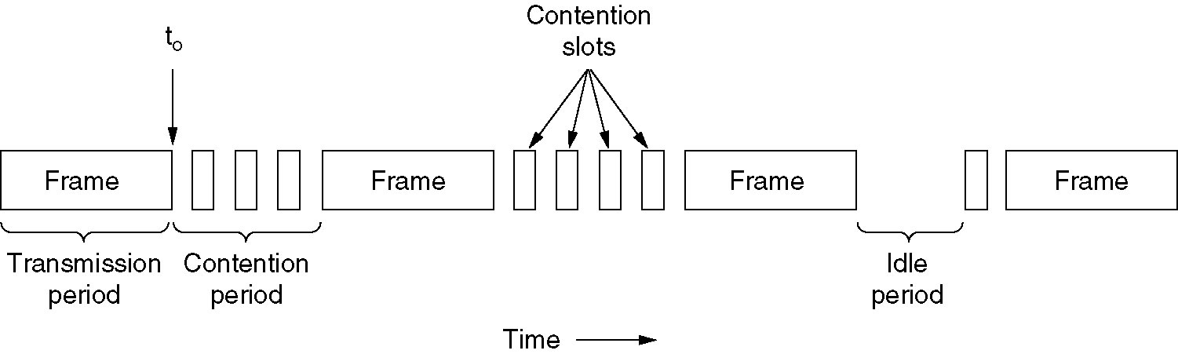
CSMA with collision detection

Slide 38
CSMA with collision detection
At time t0 station has finished transmitting its frame
Any other station now having frame to send may now attempt to do so
If two or more station transmits : Collision
Collision can be detected by looking at the power or pulse width of the received signal and comparing to the transmitted signal
After detecting collision : aborts transmission: wait random amount of time and tries again assuming no other station has started transmission

Slide 39
CSMA with collision detection
Suppose that two stations both begin transmitting at exactly time t0
How long will it take to detect collision?
The minimum time to detect the collision is then just the time it takes the signal to propagate from one station to another

Slide 40
Recap
Types of multiples access protocols:
- Channel partitioning protocols: TDM, FDM
- Random access protocols: ALOHA, CSMA and its variations
- Controlled access protocols (collision free protocols)

Slide 41
CSMA with collision detection

Slide 42
Collision free protocols
CSMA/CD : collision occurs during contention phase
Affects performance when cable is long and frames are short
Collision free protocols assumption:
There are exactly N stations
Each will have unique address 0 to N-1
Propagation delay is negligible

Slide 43
Collision free protocols
Types:
1. bit-map protocol (reservation)
2. binary countdown
3. limited contention
4. adaptive tree-walk
5. toking ring

Slide 44
A Bit-Map Protocol
Each contention period consist of N slots, where N is the number of stations
It involves two phases: reservation and transmission
If station 1 has frame to transmit, it transmits bit 1 at 0th slot
Station 1 can transmit 1 during slot 1 only, nobody else will be given chance to transmit during that slot
In general station j may announce that it has a frame to send by inserting a 1 bit into slot j.

Slide 45
A Bit-Map Protocol
After all slots have passed by, each station has complete knowledge of which station wish to transmit.
Then actual transmission begins
Since everyone agrees on who goes next there will be no collision
After last ready station has transmitted its frame, next contention period starts again

Slide 46
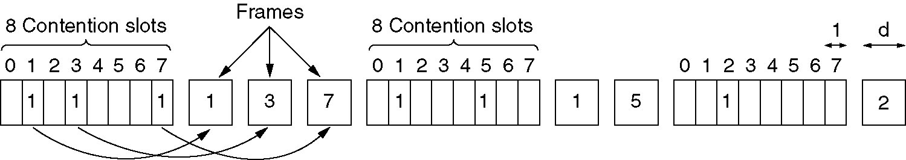
A Bit-Map Protocol

Slide 47
A Bit-Map Protocol
If a station gets ready to transmit just after its bit slot has passed by, it has to remain silent until every station had completed transmission and next contention period starts
Protocols in which desire to transmit is broadcast before actual transmission are known as reservation protocols

Slide 48
Performance of Bit-Map Protocol
Under low load, the bit map will be repeated over and over for lack of data frames
For example station 0 and 1 became ready to send, the “current slot” will be in middle of the bit map
Station will have to wait on an average N/2 slots for the current scan to be completed and another full N slots before starting transmission
High numbered slot has to wait only N/2 slots

Slide 49
Binary Countdown protocol
Problem with basic bit map: does not scale well with network having thousands of stations
In this, each station will have binary address
Assumption: Address of all station will be of same length
Higher numbered stations have higher priority than lower numbered stations

Slide 50
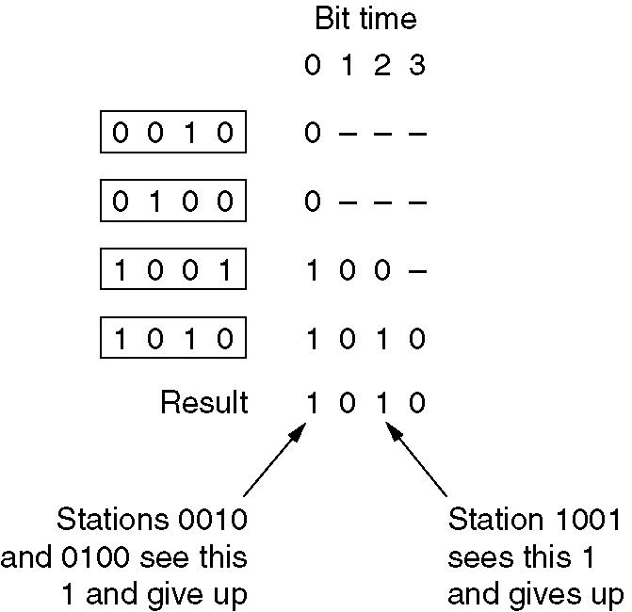
Binary Countdown protocol
A station wanting to use the channel
broadcasts its address as a binary string
starting with the high-order bit
●The bits from different stations are
ORed
●As soon as a station sees that a high-
order bit position that is 0 in its address
has been overwritten to a 1, gives up

Slide 51
Limited Contention Protocols
these protocols combines the advantages of collision based protocols and collision free protocols
Two techniques for channel allocation:
Contention: CSMA
Collision free protocols
light load: Aloha preferable: due to its less delay
High load: more collision: collision free protocols preferable

Slide 52
Limited Contention Protocols
Technique that used contention at low load to provide low delay and collision free technique at high load to provide good channel efficiency.
Such protocol are known as limited contention protocols

Slide 53
Limited Contention Protocols
In earlier protocols: stations acquire channel with probability p.
All stations acquire channel with same probability
This is known as symmetric protocols
But sometimes performance can be improved by using a protocol that assigns different probability to each station known as asymmetric protocols

Slide 54
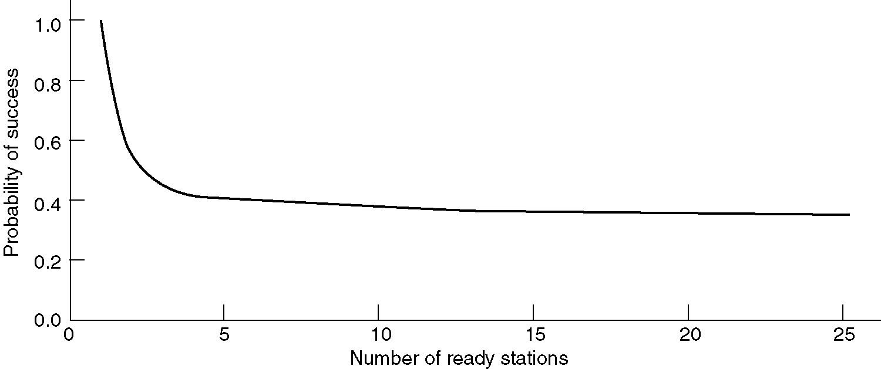
Limited Contention Protocols
Probability of some stations acquiring channel can be increased if
competition is reduced. How to reduce competition?

Slide 55
Limited Contention Protocols
First divide the stations into groups
Only the members of group 0 are allowed to compete for slot 0
If one of them succeeds it acquires the channel and transmits the frame
By making appropriate division of stations into groups the amount of contention for slots can be reduced
How to assign stations to slots?

Slide 56
Limited Contention Protocols
As an extreme case one group has one member
Guarantees that there will be no collision :binary countdown
Next case: Assign two stations per slot
The probability that both will try to transmit during a slot is p 2
As more and more stations are added how stations will be assigned to slot?
One method is adaptive tree walk protocols

Slide 57
Adaptive Tree Walk Protocols
Based on algorithm devised by the U.S Army for testing soldiers for syphilis during world war II
Army took a blood sample from N soldiers
A portion of each sample was poured into a single test tube
This mixed sample was then tested for antibodies

Slide 58
Adaptive Tree Walk Protocols
If none were found soldiers in the group were declared healthy
If antibodies were present two new mixed samples were prepared
one from soldiers 1 through N/2 and one from the rest
The process was repeated recursively until the infected soldiers were determined

Slide 59
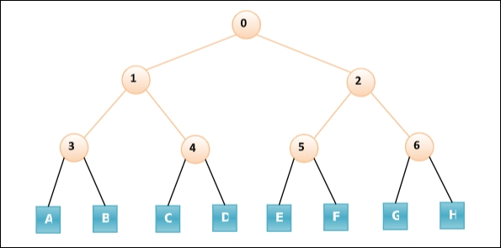
Adaptive Tree Walk Protocol
the stations or nodes are arranged in the form of a binary tree as follows

Slide 60
Adaptive Tree Walk Protocol
In the first contention slot following a successful frame transmission, slot 0, all stations are permitted to try to acquire the channel.
If one of them does so, fine. If there is a collision, then during slot 1 only those stations falling under node 1 in the tree may compete.
If one of them acquires the channel, the slot following the frame is reserved for those stations under node 2.
If, on the other hand, two or more stations under node 3 want to transmit, there will be a collision during slot 1, in which case it is node 4's turn during slot 2.

Slide 61
Token ring protocol
Introduction of a token (determined bit sequence)
● Only the owner of the token is allowed to send
● Token is cyclically passed on between all stations
●particularly suitable for ring topologies

Slide 62
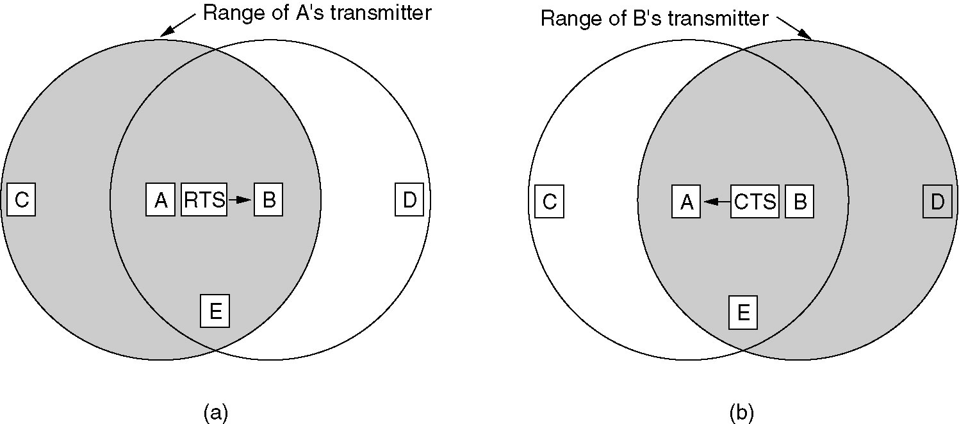
MACA (Multiple Access with collision Avoidance) or MACAW

Slide 63
Ethernet
IEEE has standardized a number of local area networks and metropolitan area networks under name IEEE 802
Most important are 802.3 (Ethernet) and 802.11 (wireless LAN)
It defines a number of wiring and signaling standards for the Physical Layer of the OSI networking model as well as a common addressing format and Media Access Control at the Data Link Layer.

Slide 64
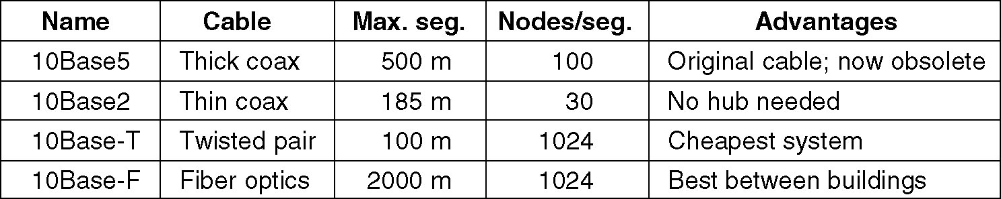
Ethernet Cabling
Four types of are used in Ethernet.

Slide 65
10Base5
Known as Thick Ethernet
With marking at every 2.5 meters to show where the taps will be inserted
Vampire taps are used to make connection with it, in which pin is forced halfway into the coaxial cable
10Base5 means it operates at 10 Mbps, uses baseband signaling, and can support segments upto 500 meters

Slide 66
10Base2
Known as Thin Ethernet
It bends easily in contrast to 10Base5
Connection is made using BNC connectors to form T junctions
BNC connectors are more reliable and easy to use
Thin Ethernet is much cheaper
Runs only for 185 meters per segment, each of which can handle only 30 machines

Slide 67
10Base5 and 10Base2
Major problem: detecting cable breaks, excessive length, bad taps, or loose connectors
Technique to track:
Pulse of known shape is injected into cable
if the pulse hits an obstacle or end of cable an echo will be generated and sent back
interval between sending the pulse and receiving the echo can be used to identify the origin of echo
Technique is known as time domain reflectometry

Slide 68
10Base5 and 10Base2
Cable breaks lead to new kind of wiring
All stations have a cable running to a central hub in which they are connected electrically.
These wires are Twister pair cables
Scheme is known as 10Base-T
Hubs do not buffer incoming traffic

Slide 69
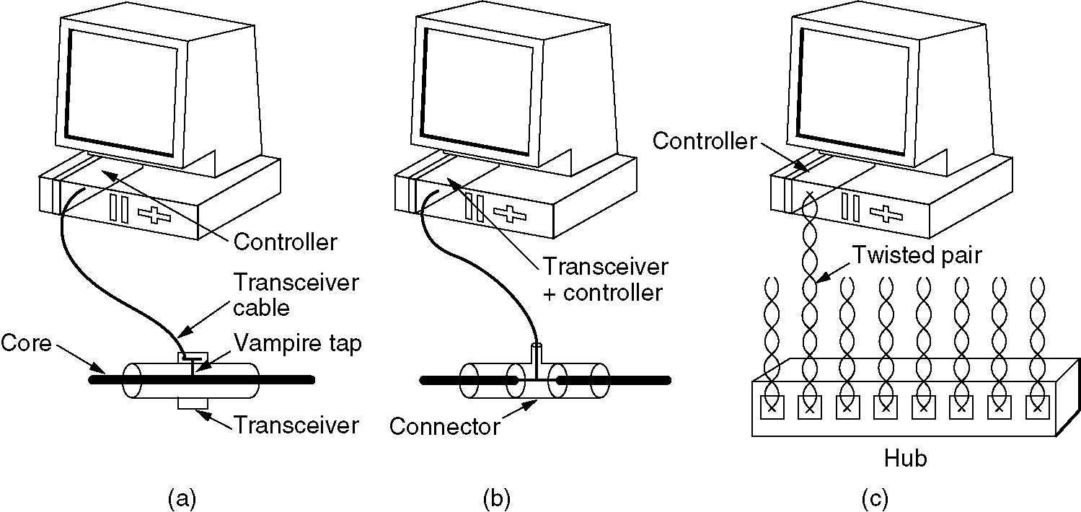
10Base5 ,10Base2, 10Base-T

Slide 70
10Base5
with 10Base5, a transceiver cable connects the transceiver to an interface board in the computer
The transceiver cable may be up to 50 meters long
Contains five individual shielded twisted pairs
Two pairs are for data in and out
Two are for control signals in and out
Fifth pair is not always used, it is used to power the transceiver electronics.

Slide 71
10Base5
Transceiver cable terminates on an interface board inside the computer
Interface board contains controller chip
Controller chip transmits frames to an d receives frame from transceiver
Controller is responsible for assembling frame and arranging them in proper format

Slide 72
10Base2
Connection to cable is BNC T-Junction connector
The transceiver electronics are on the controller board

Slide 73
10BaseT
No shared cable
Hub: to which all stations are connected with separate cable
Adding or removing station is easier and cable break detection is easier
Disadvantage: Maximum cable runs from the hub is 100 meters or 200 meters

Slide 74
10BaseF
Uses fiber optics
More expensive due to the cost of connectors and terminators
Good noise immunity
Runs up to km are allowed
good security
tapping fiber is difficult compare to copper wire

Slide 75
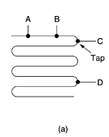
Linear Topology
A single cable is snaked from room to room, with each station tapping into it at the nearest point.

Slide 76

Spine Topology
A vertical spine runs from the basement to the roof, with horizontal cables on each floor connected to the spine by special amplifiers (repeaters).

Slide 77
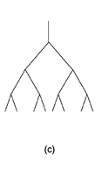
Tree Topology

Slide 78
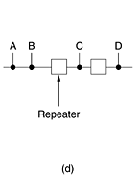
Segmented Topology
Ethernet has maximum cable length
Repeaters are required for long distance
Repeaters are physical layer device

Slide 79
Manchester Encoding
None of the Ethernet use straight binary encoding
0 volts for 0 bit and 5 volts for bit 1: Ambiguity
If one station sends bit string 0001000, others might interpret it falsely as 10000000
because they cannot tell difference between 0 volt for 0 bit and idle sending

Slide 80
Manchester Encoding
Problem: Need for receivers to unambiguously determine start, end or middle of each bit without reference of global clock
Two approaches
Manchester Encoding
Differential Manchester Encoding

Slide 81
Manchester Encoding
Manchester encoding each bit period is divided into two equal intervals
A binary bit 1 is sent by having the voltage set high during the first interval and low in the second one
A binary 0 is just the reverse : first low and then high
Requires twice the bandwidth of binary encoding

Slide 82
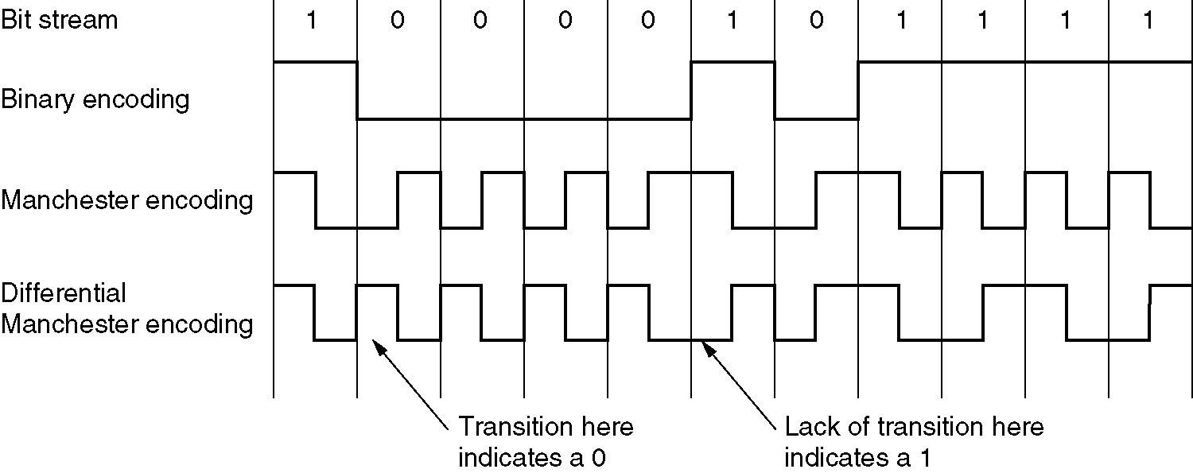
Manchester Encoding

Slide 83
Differential Manchester Encoding
Variation of basic Manchester encoding
1 bit is indicated by the absence of a transition at the start of interval
A 0 bit is indicated by the presence of a transition at the start of interval

Slide 84

The Ethernet MAC sub layer Protocol
DIX (DEC, Intel, Xerox) frame structure
Preamble bit pattern : 10101010
Manchester encoding of this pattern produces a 10 MHz square wave for 6.4 µsec.

Slide 85
The Ethernet MAC sub layer Protocol
Two addresses for source and destination
address of 2 bytes or 6 bytes are allowed
Destination address higher order bit is 0 for ordinary address
1 for group address : Multicasting
All 1 for broadcast

Slide 86
The Ethernet MAC sub layer Protocol
Bit 46 is used to check for global address and local address
Local address are assigned by each network administrator
Have no significance outside the network
Global address are assigned by IEEE to ensure no two stations in world have same address
With 48-2= 46 bits, there are about 7 * 10³ global addresses

Slide 87
The Ethernet MAC sub layer Protocol
Type field: Tells the receiver what to do with frame. it specifies which process to give the frame to.
Data field: max up to 1500 bytes
There is also constraint for minimum size of frame
If data field is of 0 bytes it causes a problem
When a transmitter detects collision, it truncates the current frame
So many stray bits and pieces of frames appear on the cable

Slide 88
The Ethernet MAC sub layer Protocol
How receiver will distinguish between valid frames and garbled frames even when data of valid frame is 0 bytes
So condition is decided that minimum frame size should be 64 bytes long
When data field is less than 46 bytes, padding field is used to fill out the frame up to minimum size.

Slide 89
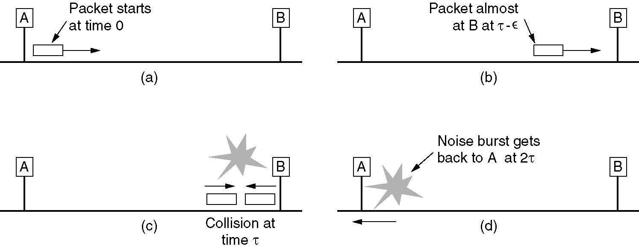
The Ethernet MAC sub layer Protocol

Slide 90
The Ethernet MAC sub layer Protocol
Checksum field: Used for error detection
32 bit hash code

Slide 91
The Binary Exponential Back off Algorithm
Slot time has been set to 512 bit times or 51.2 µsec
After the first collision each station waits wither 0 or 1 slot times before trying again
If two stations collide and each picks the same random number they will collide again

Slide 92
The Binary Exponential Back off Algorithm
After the second collision each one picks either 0, 1, 2 or3 at random and waits that number of slot times
If a third collision occurs (Probability 0.25) then the number of slot to wait is chosen from the interval 0 to 2³-1.

Slide 93
The Binary Exponential Back off Algorithm
In general after i collision, a random number between 0 and 2^{i} - 1 is chosen and that number of slots is skipped
After 16 collisions controller reports failure back to computer
This algorithm is known as binary exponential back off algorithm.

Slide 94
Switched Ethernet
As more and more stations are added, traffic will increase and LAN will saturate
One way increase speed from 10 Mbps to 100 Mbps.
But with growth of multimedia, even a 100 Mbps or 1Gbps Ethernet can become saturate.

Slide 95
Switched Ethernet
Switch contains high speed backplane and 4 to 32 plug in line cards
Each plug in line cards contains one to eight connectors
Each connector has a 10BaseT twisted pair connection to a single host computer

Slide 96
Switched Ethernet
Simple Ethernet topology is based on shared Ethernet that is any message transmitted is heard by all connected machines, available bandwidth is shared by all machines
Switch Ethernet uses switching and filtering mechanism
It inspects source and destination address in frame
Switch knows which machine is connected to which port and transmit frame to port with destination machine.

Slide 97
Switched Ethernet
Other ports will remain free for other transmission
When a station wants to transmit an Ethernet frame, it outputs a standard frame to switch

Slide 98
Switched Ethernet
The plug in card getting the frame will check to see if it is destined for other stations connected to the same card
If so frame is copied there, if not frame is sent to high speed backplane to the destination’s card.
Switched Ethernet uses star topology
Speed 10Mbps.

Slide 99
Fast Ethernet
To achieve more speed than traditional Ethernet IEEE decided to come up with fast Ethernet
Fast Ethernet provides more speed of 100 Mbps
Known as 802.3u or fast Ethernet
Basic idea is to keep all the old frame formats, interfaces, and procedural rules as it is
But reduce bit time from 100nsec to 10nsec

Slide 100
Check from Tanenbaum
Fast Ethernet
Gigabit Ethernet

Slide 101
Data Link layer Switching
Many organizations have multiple LANs and wish to connect them
LANs can be connected using bridges
Bridges operate at DLL
Bridges check DLL address to do routing
Bridges are different from routers
Routers operate at network layer and check network layer address that is IP address for do routing.

Slide 102
Data Link layer Switching
When bridges can be used?
First Reason:
Many departments in corporate, university etc.
Each developed LAN according to there own feasibility
Sooner or later need arise for there interaction
Bridges are used

Slide 103
Data Link layer Switching
Second Reason:
Organization may be geographically spread among several buildings
It may be cheaper to have separate LANs in each building and connect them with bridges and laser links than to run a single cable over the entire site.

Slide 104
Data Link layer Switching
Third Reason:
It may be necessary to split a single LAN into separate LANs to accommodate more load
For example : At many universities thousands of workstations are available for student and faculty computing.

Slide 105
Data Link layer Switching
Files are normally kept on file server machines and are downloaded to users' machines upon request.
The enormous scale of this system precludes putting all the workstations on a single LAN—the total bandwidth needed is far too high. Instead, multiple LANs connected by bridges are used

Slide 106
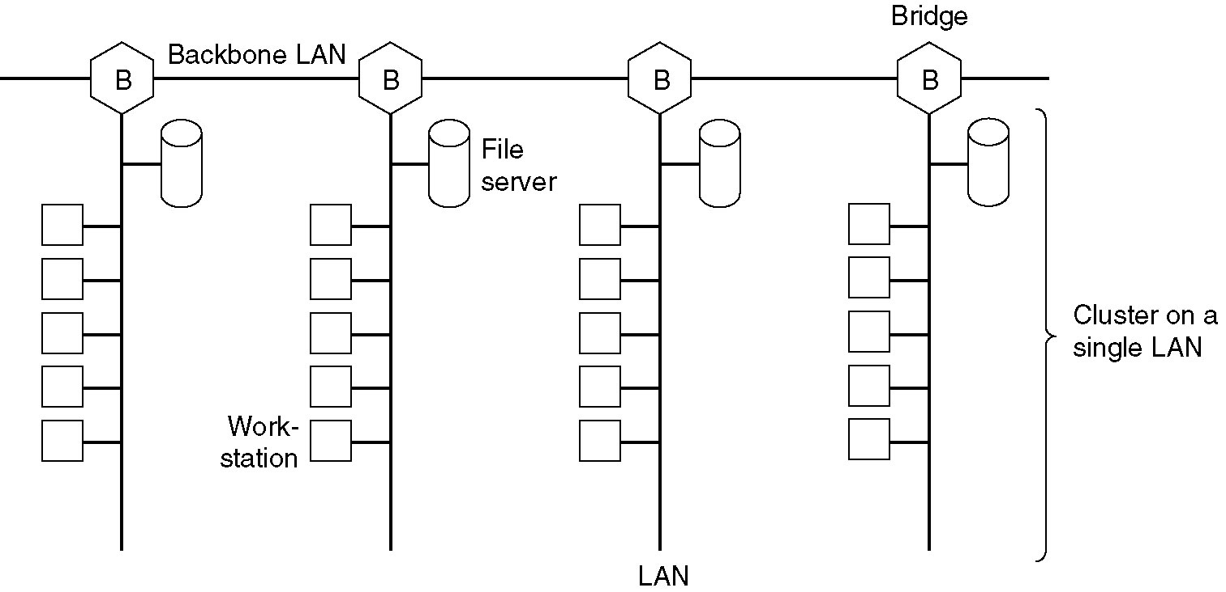
Data Link layer Switching

Slide 107
Data Link layer Switching
Fourth Reason:
Sometimes a single LAN is enough but distance between two most distant machine is too great
Even if laying cable can work but round trip delay will increase
Solution partition the LAN and install bridges between the segments

Slide 108
Data Link layer Switching
Fifth Reason:
For reliability
Bridges can be designed in such a way that it can identify good packets and garbled packets.
If any node is transmitting garbled packets bridge can stop forwarding it further

Slide 109
Data Link layer Switching
Sixth Reason:
Security
By inserting bridges at various places and being careful not to forward sensitive traffic, a system administrator can isolate parts of the network so that its traffic cannot escape and fall into the wrong hands.

Slide 110
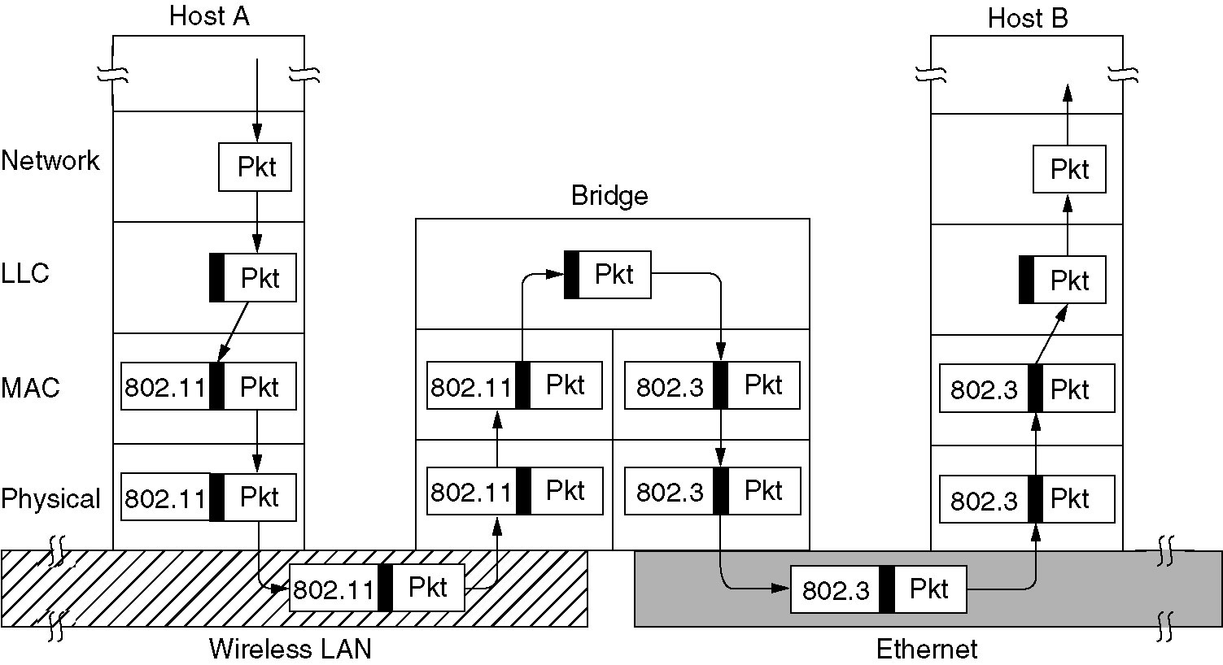
Bridges from 802.x to 802.y
Bridge connecting K different LANs will have k different MAC
sub layers and K different physical layers one for each type

Slide 111
Problems with LANs and bridges
1.Each of the LANs uses different frame format
For example duration field is there in 802.11 due to MACAW protocol and make no sense in Ethernet
As a result any copying between different LAN will require reformatting, which takes CPU time, requires a new checksum calculation, and introduces possibility of undetected errors due to bad bits in bridges memory

Slide 112
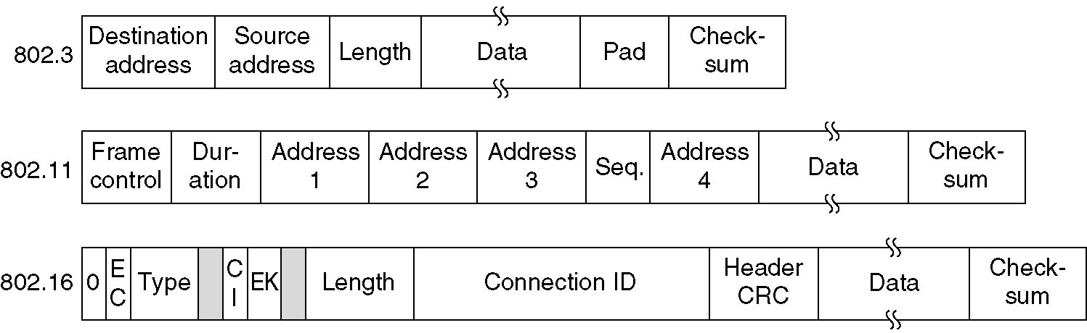
Different frame formats

Slide 113
Problems with LANs and bridges
2. Interconnected LANs that do not run at same data rate
When forwarding many long frames from a fast LAN to slow one, the bridge will not be able to get rid of the frame as fast as they come in
Bridge will have to buffer them
Bridges that connect two or more LANS need to buffer frames from many LANs without running out of buffer memory

Slide 114
Problems with LANs and bridges
3. Each 802 LANs have different maximum frame lengths
Problem arises when a long frame is forwarded to a LAN which cannot accept frame of that length
Splitting the frame out into pieces is not possible as DLL do not provide facility of reassembling pieces of frame
Frames that are too large to be forwarded must be discarded

Slide 115
Problems with LANs and bridges
4.Security
Both 802.11 and 802.16 supports encryption
Ethernet do not support encryption
This means various encryption services provided to the wireless networks are lost when that frame pass through Ethernet network
or even when that frame arrive at Ethernet network there will be no way to decrypt it as Ethernet is not supporting encryption and decryption

Slide 116
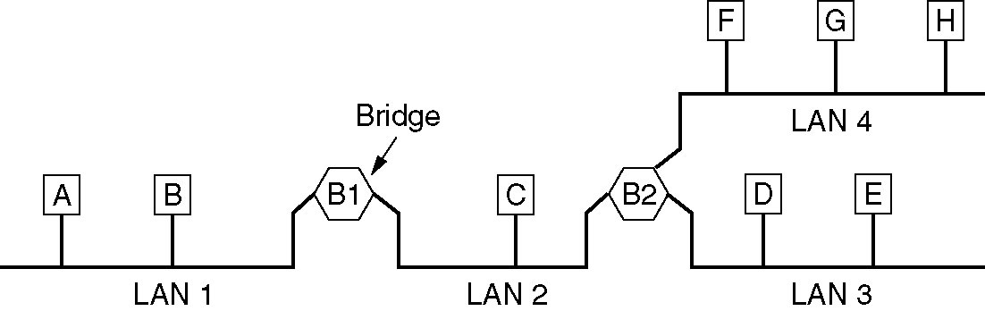
Local Internetworking
Bridges should be totally transparent from all machines
Bridge will accept every frame transmitted on all the LANs to which it is connected
A frame arriving at bridge B1 on LAN 1 destined for A can be discarded immediately, because it is already on the correct LAN, but a frame arriving on LAN 1 for C or F must be forwarded.

Slide 117
Local Internetworking
When a frame arrive at bridge, it must decide whether to discard frame or to forward it and latter on which LAN to put the frame
This decision will be based on entry of big hash table at each bridge
Table include entry for each possible destination and tell which output line it belongs to
For example, B2's table would list A as belonging to LAN 2, since all B2 has to know is which LAN to put frames for A on.

Slide 118
Local Internetworking
When the bridges are first plugged in all the hash tables are empty.
None of the bridges know where any of the destinations are, so they whenever frame will arrive they will just flood it
Later on bridge will learn where destinations are
Once a destination is known frames are put on appropriate LAN

Slide 119
Local Internetworking
If bridge B1 sees a frame on LAN 2 coming from C, it knows that C must be reachable via LAN 2, so it makes an entry in its hash table noting that frames going to C should use LAN 2.
Any subsequent frame addressed to C coming in on LAN 1 will be forwarded, but a frame for C coming in on LAN 2 will be discarded.
In this way bridges learn about destination and method is known as backward learning

Slide 120
Local Internetworking
The routing procedure for incoming frame depends on the LAN it arrives on and the LAN its destination is on as follows:
If destination and source LANs are the same, discard the frame
If the destination and source LANs are different, forward the frame
If the destination is unknown, use flooding

Slide 121
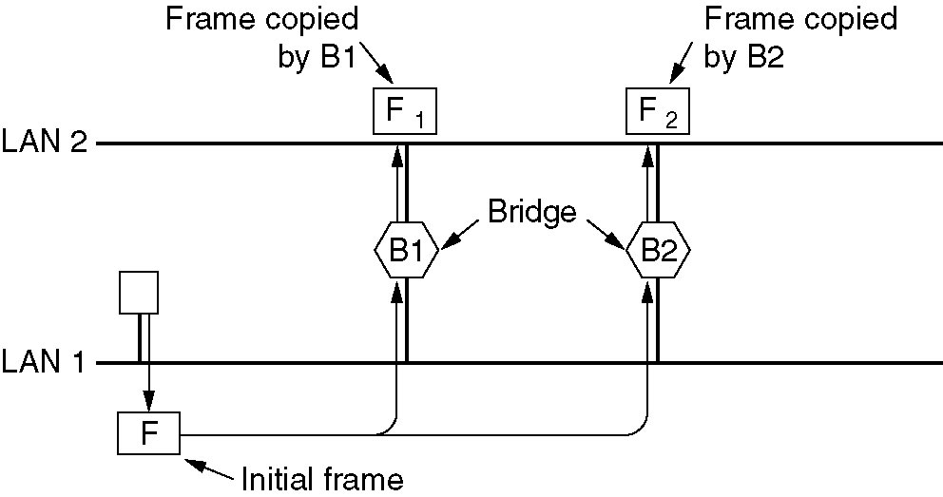
Spanning Tree Bridges
To increase reliability some sites use two or more bridges in parallel between pairs of LANs

Slide 122
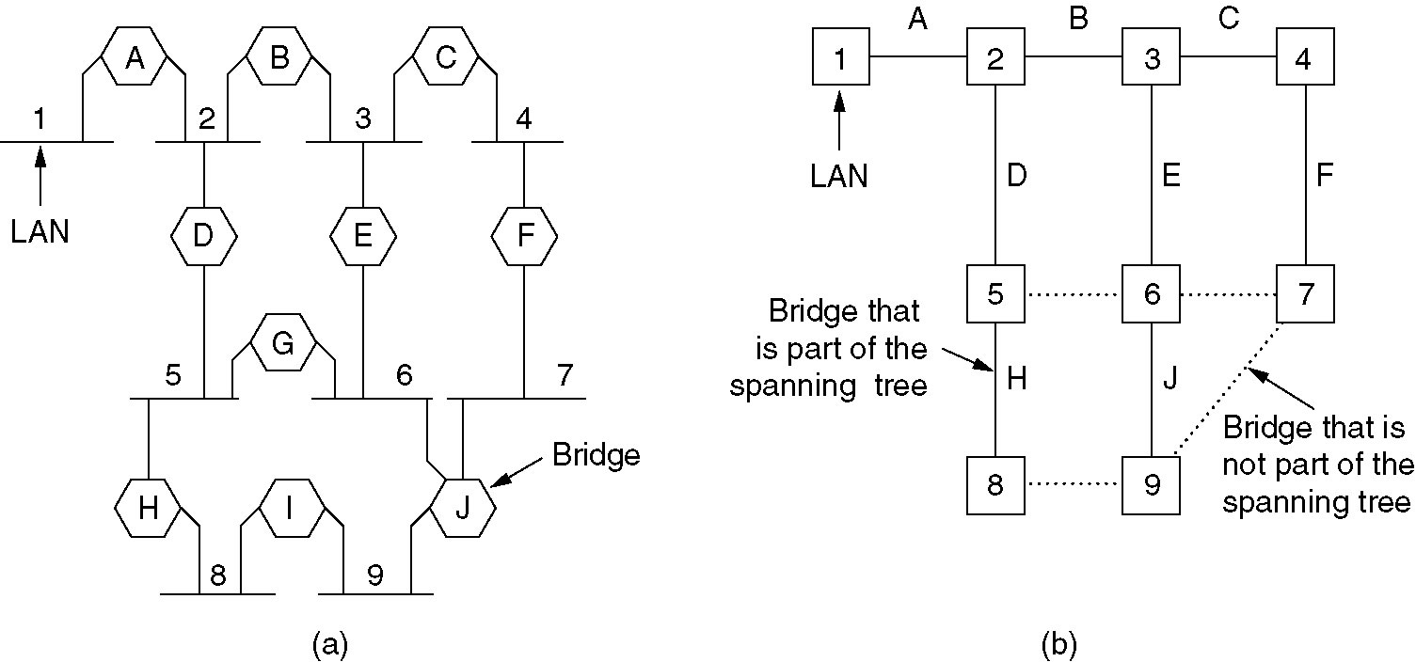
Spanning Tree Bridges

Slide 123
Spanning Tree Bridges
To build the spanning tree first the bridges have to choose one root of the tree.
All bridge will broadcast there unique serial number given by manufacturer
The bridge with the lowest serial number becomes the root
Next a tree of shortest paths from root to every bridge and LAN is constructed
The result of this algorithm is unique path is established from every LAN to the root and thus to every other LAN

Slide 124
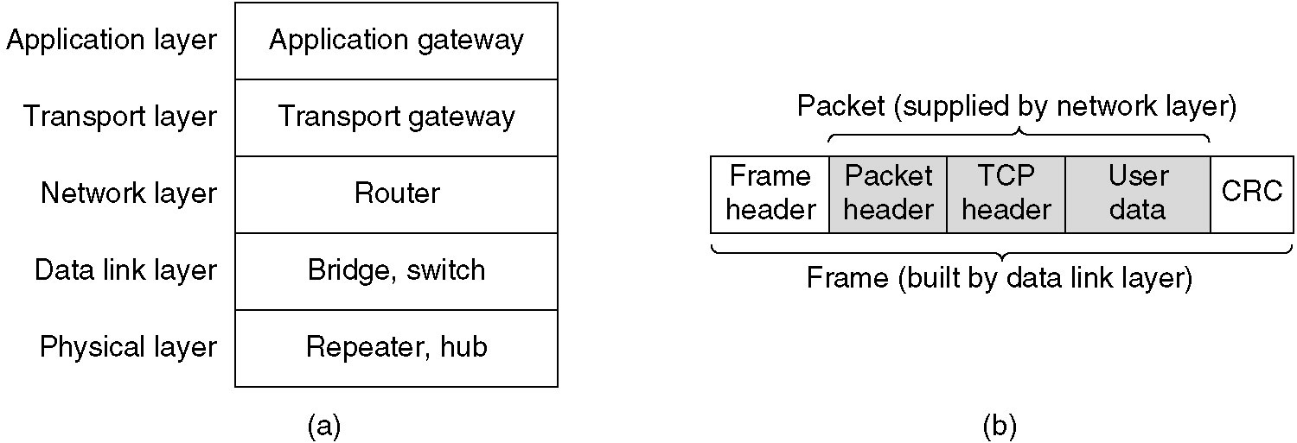
Repeaters, Hubs, Bridges, Switches, Routers, and Gateways
All devices operate at different layers
Layer matters because different devices use different pieces of information to decide how to switch

Slide 125
Repeaters
All signals fade as they travel from one place to another.
Each type of network cable has a maximum useable length. If you go beyond that length, the signal will be too weak to be useful.
Of course, computers on a real network can easily be more than 200 metres apart. Therefore the network cable is split up into segments. Each segment is less than the maximum length allowed. Joining the segments together is a device known as a 'Repeater'.

Slide 126
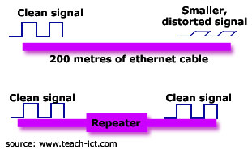
Repeaters
A Repeater boosts the signal back to its correct level.
Here are some typical maximum cable lengths:
Copper cable - 100 m
Thick Ethernet -500m
Thin Ethernet - 185m

Slide 127
Repeaters
At physical layer
These are analog devices that are connected to two cable segments
A signal appearing on one of them is amplified and put out on the other
They do not understand frames, packets or headers
They only understand volts
For example Ethernet allows to insert four repeaters to extend cable from 500 meters to 2500 meters

Slide 128
Hubs
At physical layer
Hub has number of input lines that it joins electrically
Frames arriving on one lines are sent out on all the others
IF two frame arrives at the same time they will collide
All the lines coming into a hub must operate at same speed
Hubs differ from repeaters in that they do not (usually) amplify the incoming signals and are designed to hold multiple line cards each with multiple inputs.

Slide 129
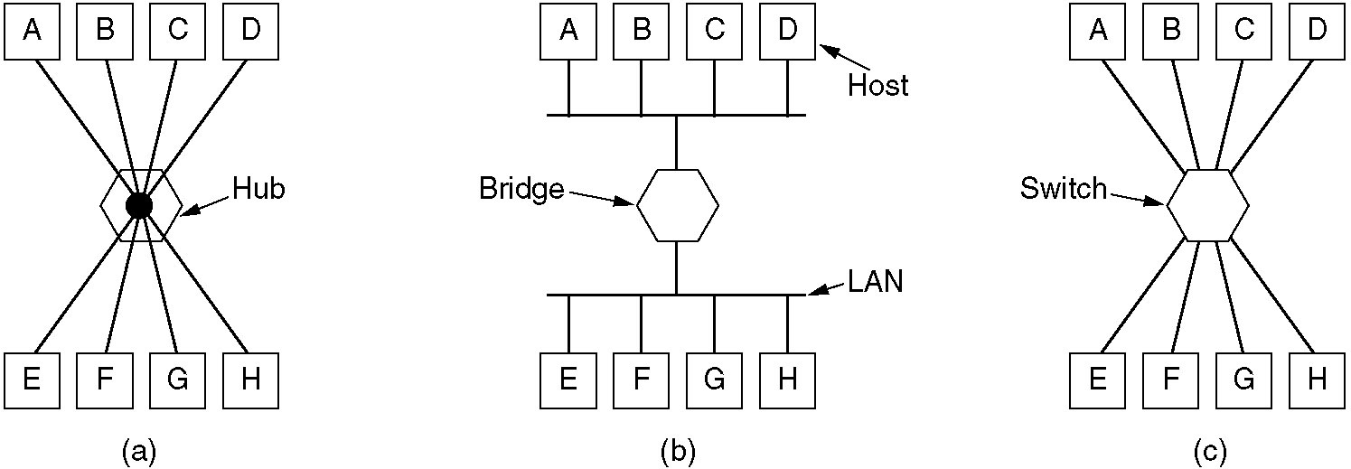
Hubs
Do not determine the path
A hub can be a passive or active
Active hub repeat signal sent through them
Passive hub do not repeat but merely split signals sent through them

Slide 130
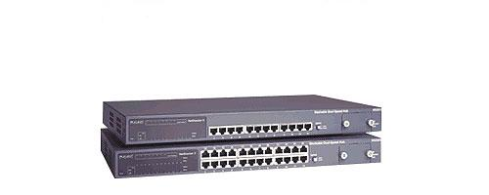
Hubs

Slide 131
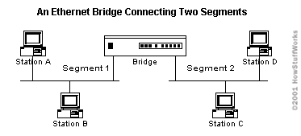
Bridges
At data link layer
Connects two or more LANs
When a frame arrives, software in the bridge extracts the destination address from the frame header and looks it up in a table to see where to send the frame.

Slide 132
Bridges
Problems with Bridge
They work well when there is not too much inter-segment traffic, but when the inter-segment traffic becomes too heavy the bridges can actually become a bottleneck for traffic, and actually slow down communication.
They spread and multiply broadcast. A bridge forwards all broadcast to all other connected segments. If there are too many broadcast, it can result in a broadcast storm.

Slide 133
Switches
A network cable can only have one data packet in it at any instant.
So if two or more computers want to place a data packet on to the network at exactly the same time, then a 'data collision' will take place.
The network protocol is set up to deal with this. Basically it declares the collided data as unusable and forces the two computers to re-send their data packets at a slightly different time.
This is fine for a lightly loaded network with only a few computers on-line. You will not notice the small delay caused by data collisions.

Slide 134
Switches
A switch has a number of ports and it stores the addresses of all devices that are directly or indirectly connected to it on each port.
As a data packet comes into the switch, its destination address is examined and a direct connection is made between the two machines.
A switch is a very fast, low-latency, multi-port bridge that is used to segment LANs. They are typically used to increase communication rates between segments with multiple parallel conversation and also communication between different networking technologies .

Slide 135
Switches
A vital difference between a hub and a switch is that all the nodes connected to a hub share the bandwidth among themselves, while a device connected to a switch port has the full bandwidth all to itself. For example, if 10 nodes are communicating using a hub on a 10-Mbps network, then each node may only get a portion of the 10 Mbps if other nodes on the hub want to communicate as well. But with a switch, each node could possibly communicate at the full 10 Mbps.

Slide 136
Switches
Switches forwards received data frames in two ways;
Cutting-through switching: the switch reads the destination address before receiving the entire frame. The data is then forwarded before the entire frame arrives. This method has the advantage that there is less delay (latency) between the reception and transmission of a data packet.
Store-and-forward switching: it involves reading the entire Ethernet frame, before forwarding it, with the required protocol and at the correct speed, to the destination port. This has the advantage of improved error check, protocol filtering and speed matching but has the disadvantage of system delay, as the frames must be totally read before it is transmitted

Slide 137
Routers
Operate at network layer
A Router is a device that transfers data from one network to another in an intelligent way. It has the task of forwarding data packets to their destination by the most efficient route.
In order to do this, the router has a micro computer inside it. This holds a table in memory that contains a list of all the networks it is connected to, along with the latest information on how busy each path in the network is, at that moment. This is called the 'routing table'.

Slide 138
Routers
When a data packet arrives, the router does the following:-
Reads the data packet's destination address
Looks up all the paths it has available to get to that address.
Checks on how busy each path is at the moment
Sends the packet along the least congested (fastest) path.

Slide 139
Ethernet
1. Classic Ethernet
2. Switched Ethernet
3. Fast Ethernet
4. Gigabit Ethernet
5. Cabling used in Ethernet
6. Use of bridges

